Slide 1


CAPSTONE PROJECT
-E2E TESTING OF SAUCEDEMO WEBSITE
PRESENTED BY:
M.MADHUMITHA REDDY
BATCH 03,JAVA SELENIUM

Slide 2
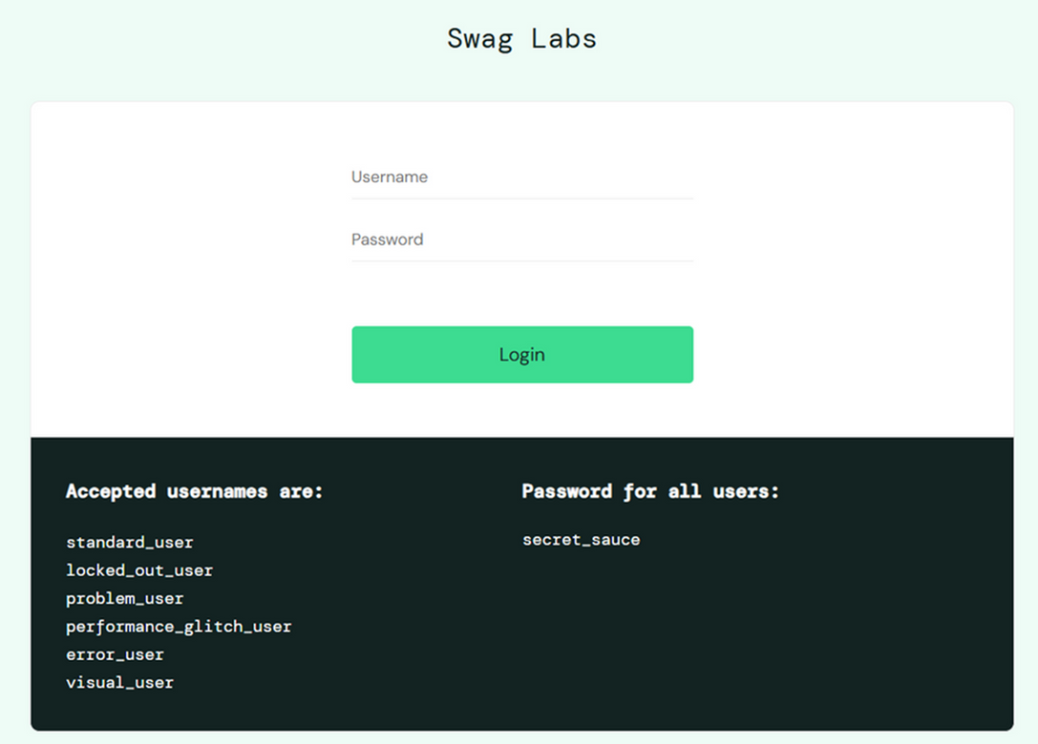
Objective:
To design and implement a robust automated testing framework for the web application SauceDemo, focusing on automating functional test scenarios, integrating with a CI/CD pipeline, and ensuring continuous validation of application stability and reliability.

Slide 3
Project Overview
APPLICATION
GOAL
TOOLS
SauceDemo E-Commerce site
Automate end-to-end test scenarios
Java, Selenium WebDriver, TestNG, Cucumber BDD
BROWSER
CI/CD
Reporting
Chrome & Edge (cross-browser)
GitHub integration
ExtentReports (HTML + Screenshots)

Slide 4
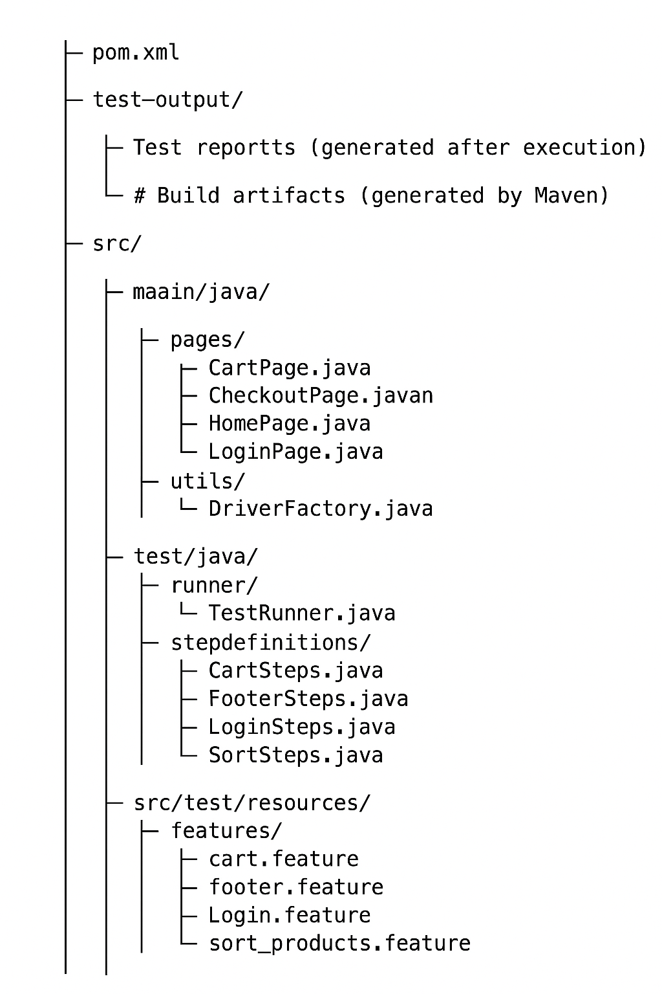
Automation Structure

Slide 5
Work Description
01
Developed automation scripts using Selenium WebDriver + TestNG + Cucumber
04
Produced detailed HTML reports with screenshots on test failure using Extent Reports
Implemented integration with Jenkins for automated test execution on each code commit
02
Conducted manual testing using Zephyr Board in JIRA for Sprint backlog management
05
03
Managed requirements and test cases in JIRA with active tracking of tasks and bugs

Slide 6
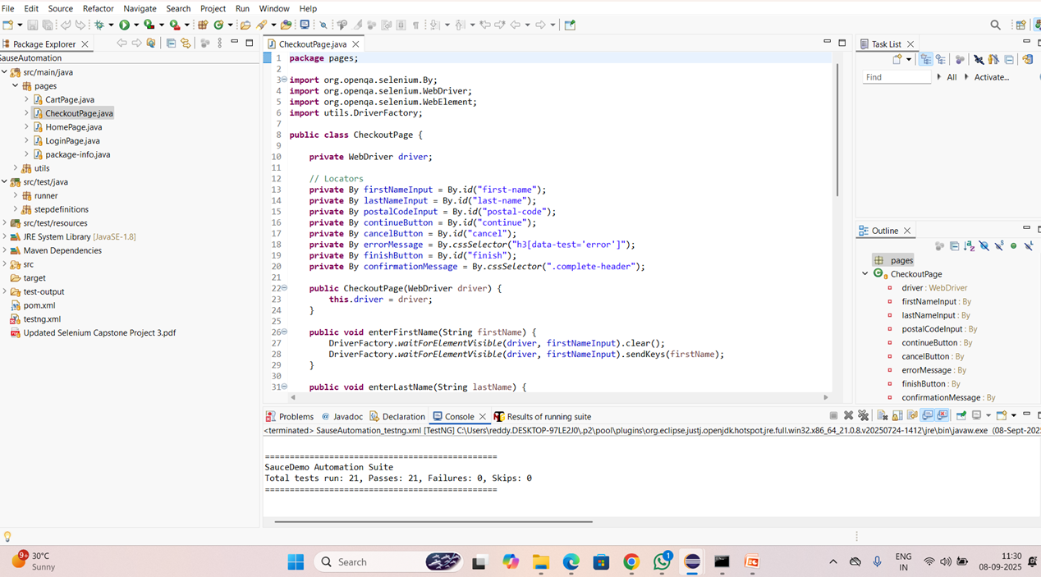
Automation Reports

Slide 7
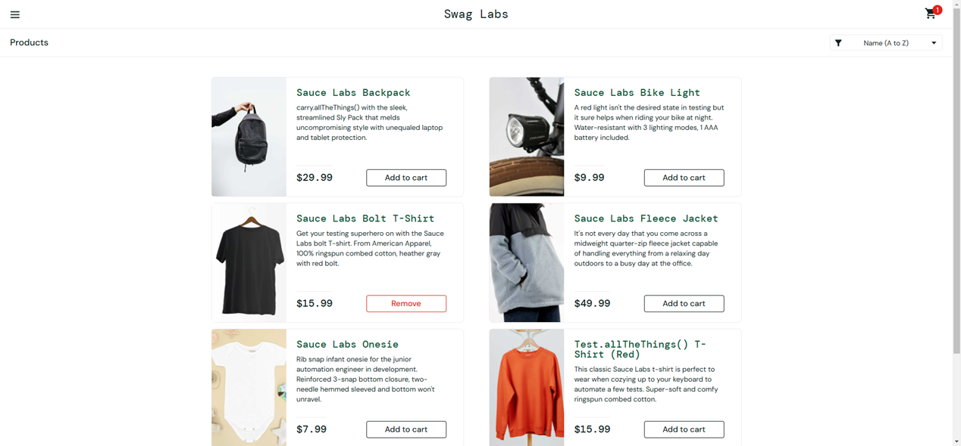
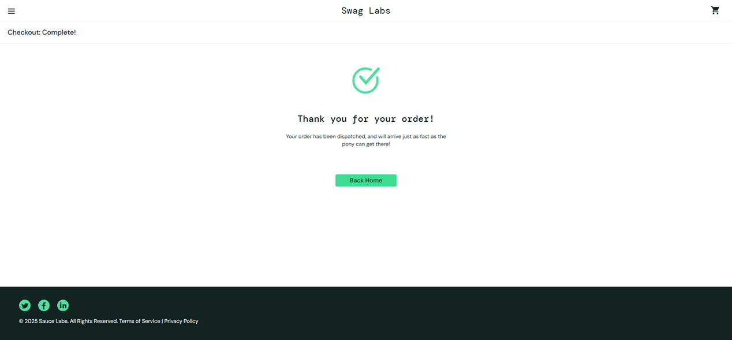
Add to cart, Checkout:

Slide 8
Manual Test Approach
Agile Methodology – Scrum Framework
User stories and test cases managed in Zephyr (Jira plug-in)
Test levels:
- Smoke Tests: Verify basic app availability
- Regression Tests: Validate core workflows after code changes
- End-to-End Tests: Simulate real user journeys
 Agile Methodology – Scrum Framework
 User stories and test cases managed in Zephyr (Jira plug-in)
 Test levels:
- Smoke Tests: Verify basic app availability
- Regression Tests: Validate core workflows after code changes
- End-to-End Tests: Simulate real user journeys
Zephyr Reports generated

Slide 9
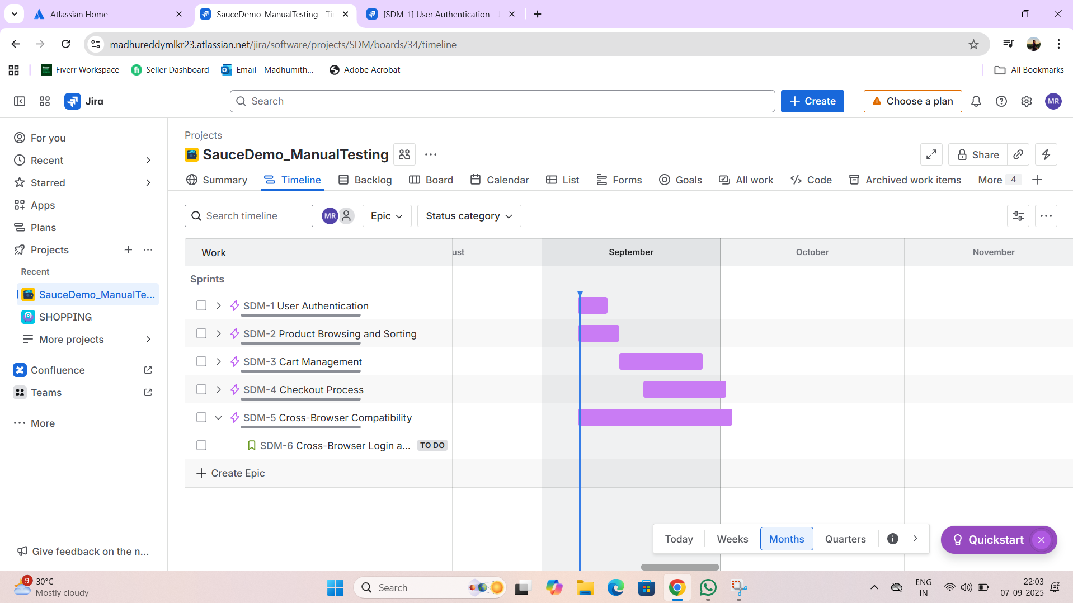
Agile Board-zephyr

Slide 10
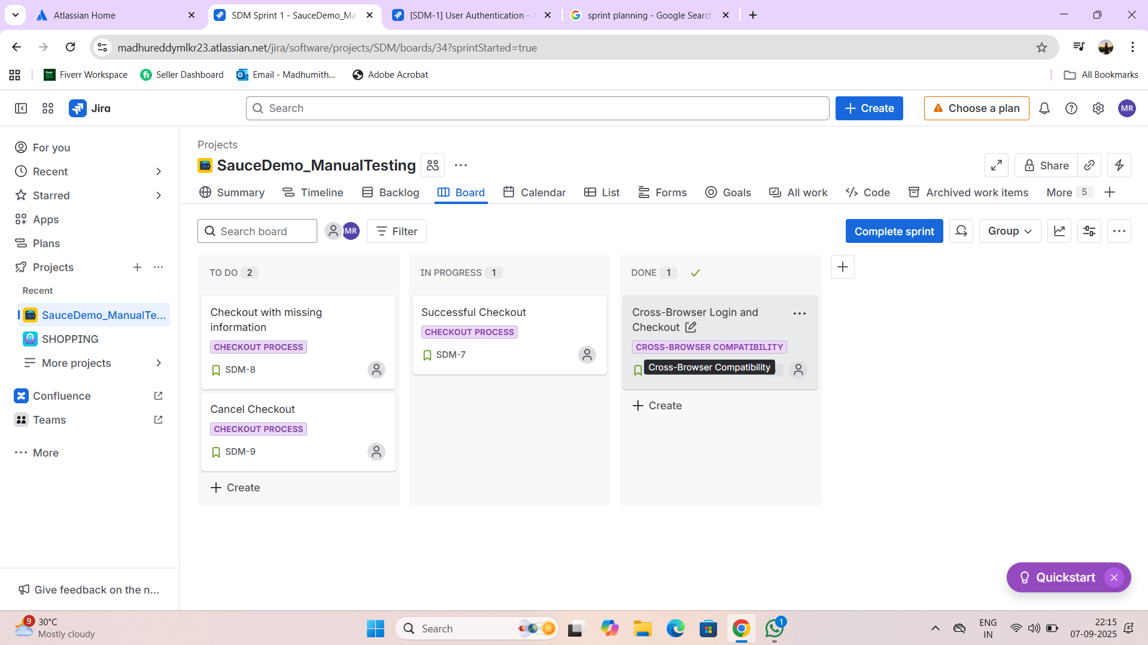
Sprint creation

Slide 11
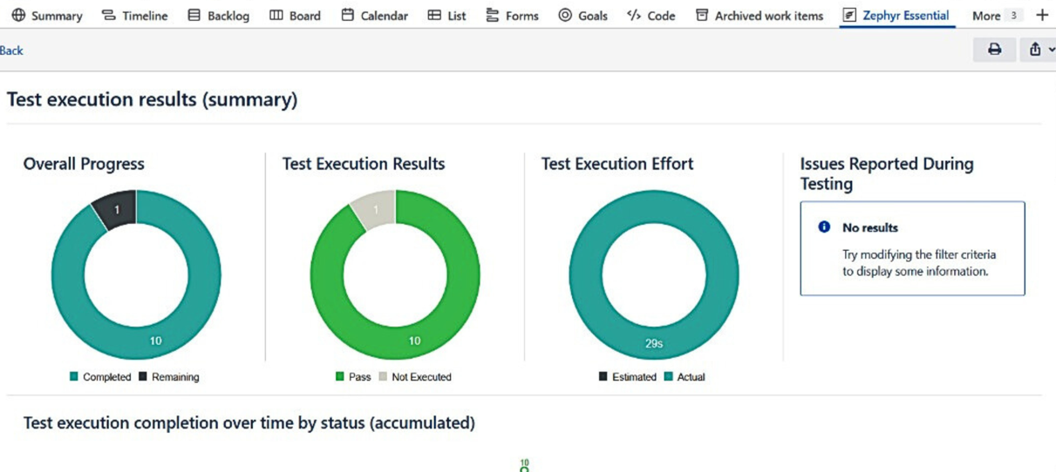
Zephyr Reports

Slide 12
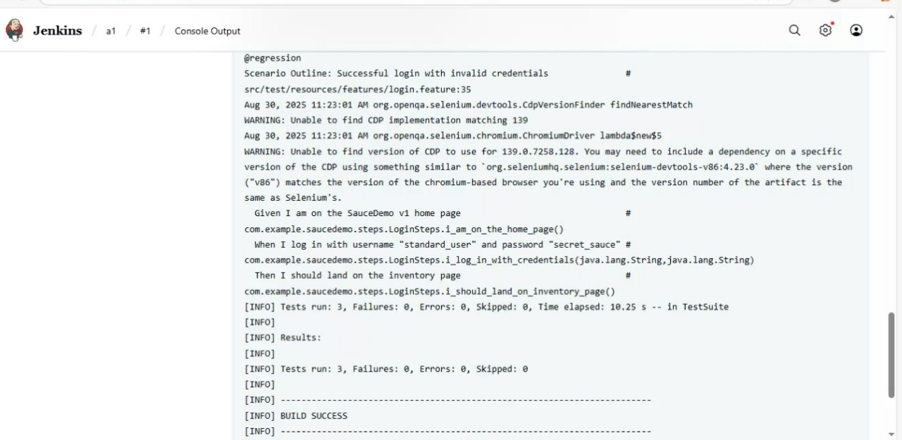
Jenkins for CI/CD

Slide 13
SUMMARY
Conducted comprehensive manual testing by designing and executing a variety of test cases, including positive, negative, and edge scenarios to ensure system reliability.
Developed a robust Selenium automation framework utilizing Java, TestNG, and Cucumber to support reusable and scalable test automation.
Performed cross-browser validation on Chrome and Edge to ensure consistent performance and functionality across platforms.
Integrated the test automation framework with GitHub for version control and Jenkins for continuous integration and deployment (CI/CD).
Utilized Jira for efficient management of user stories, test case documentation, and defect tracking.
Generated detailed test reports using Extent Reports, including visual evidence like screenshots for failed test steps.
Combined manual and automated testing strategies to maximize test coverage, reduce regression cycles, and enhance overall software quality.
References:
🔗 GitHub: https://github.com/madhureddy03/Capstone_project
🌐 Demo Site: https://www.saucedemo.com

Slide 14
Thank you very much!
PRESENTED BY M. MADHUMITHA REDDY

